Slide 1
Current State of Reasoning With LLMs
Isamu Isozaki

Slide 2

Agenda
What is Reasoning?
Emergent Abilities
Advanced prompting tech (Graph of Thought, Tree of Thought)
Analysis of LLM Reasoning
Promising approaches

Slide 3

What is Reasoning?

Slide 4
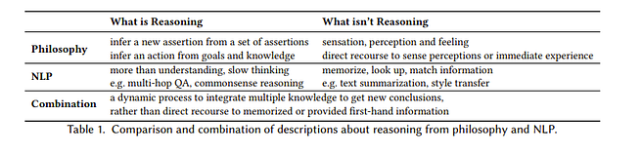
Natural Language Reasoning, A Survey
So we have to do some processing on the knowledge we already have to call it reasoning!

Slide 5
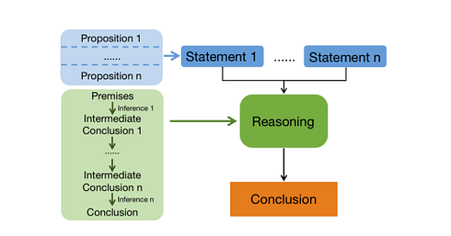

Slide 6
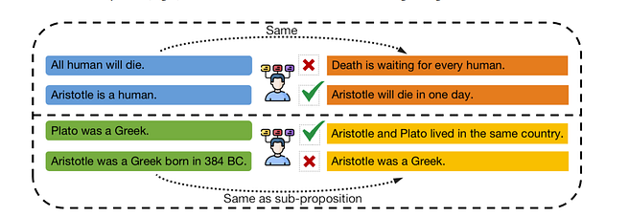
Example

Slide 7
What is inference?
Deduction = uses a fact and a rule to come up with a conclusion. Ex. Given Aristotle is a human and all humans will die, Aristotle will die
Defeasible Inference=infer the best explanation for a given phenomenon. So given Aristotle is a human, and Aristotle died, the most likely explanation is all humans will die

Slide 8
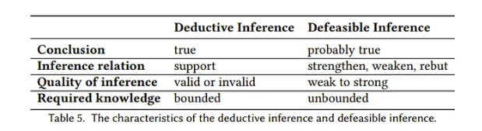

Slide 9
Requirements for Natural Language Reasoning
knowledge acquisition where relevant knowledge for reasoning is collected.
knowledge understanding where the relevant propositions underlying the knowledge are captured.
Inference which we already discussed where the premises are used to infer a conclusion given one or more steps.

Slide 10
Advantage of LLMs
LLMs understand natural language.
LLMs already have implicit knowledge like common sense without needing to mention them explicitly
In context learning. LLMs can learn from demonstrations in the prompt.
Emergent Abilities seems to improve reasoning!

Slide 11

Emergent Abilities

Slide 12
Emergent Abilities of Large Language Models
An “ability is emergent if it is not present in smaller models but is present in larger models.” Here these abilities are said to be “unpredictable” in that they are not a natural extension of say scaling laws.

Slide 13
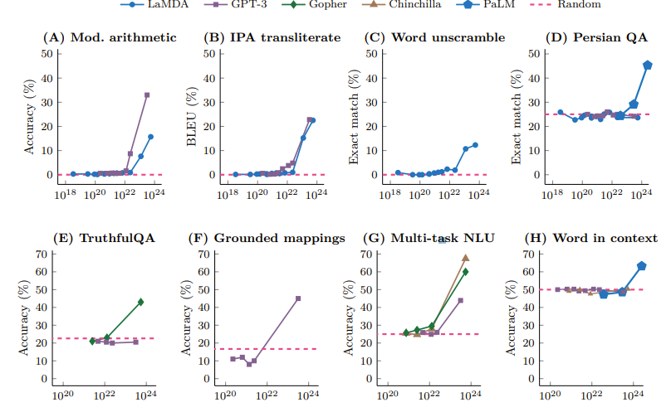
All from Big-Bench

Slide 14
Datasets used
Big-Bench which is crowd sourced benchmark with over 200 types of benchmarks such as 3-digit addition/subtraction. For this dataset, at least 13B parameters for GPT-3 architectures and 68B for LaMDA was needed where otherwise the results were close to 0.
TruthfulQA which are question and answers that GPT-3 failed to answer the authors found that after scaling to 280B params performance increases by 20% while before that the results were close to random.
MMLU which is probably the most famous task here, is a task of 57 tests with topics including math, history, law etc. For models with below 10B parameters, they do not perform better than random. However, at 70B and higher the performance is substantially better than random.

Slide 15
How about with better prompting?

Slide 16
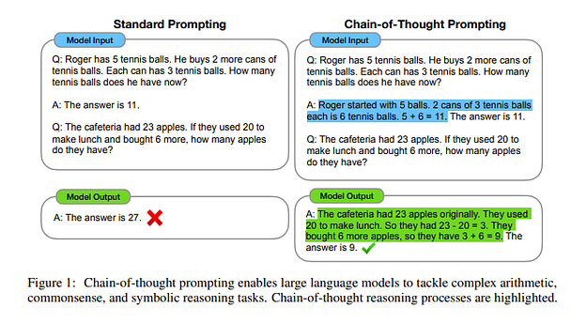
Chain-of-Thought Prompting Elicits Reasoning in Large Language Models

Slide 17
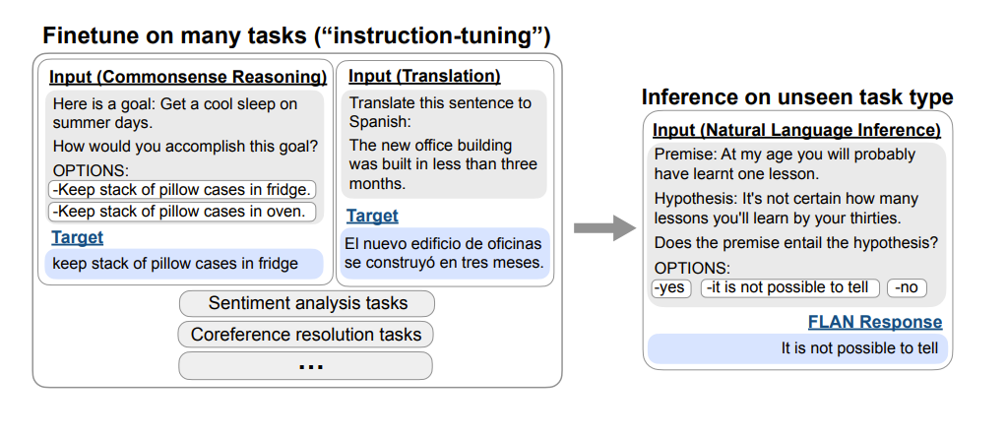
Finetuned Language Models Are Zero-Shot Learners

Slide 18
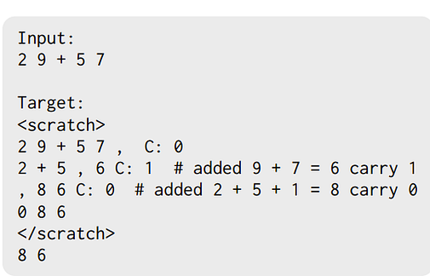
Show Your Work: Scratchpads for Intermediate Computation with Language Models

Slide 19
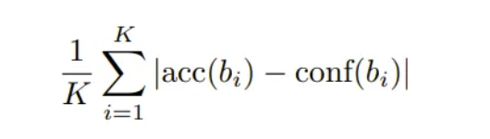
Language Models (Mostly) Know What They Know
Question: Can we get the confidence of a LLM’s answer along with the answer?
Calibration metric from “Teaching models to express their uncertainty in words”. In this paper the authors trained the model and only on arithmetic class. Can we make this good without training? Here, we get confidence just from asking the model

Slide 20
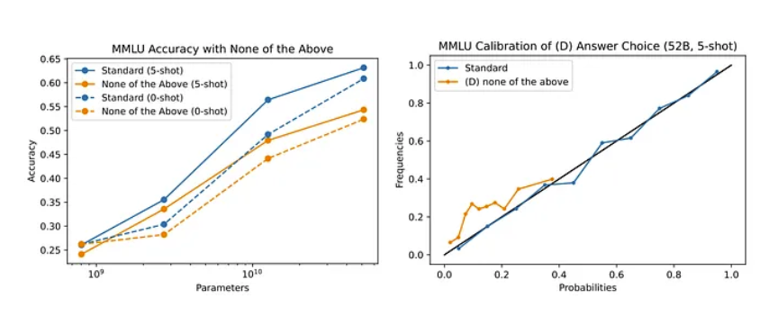
Replacing an Option with ‘None of the Above’ Harms Performance and Calibration
Frequency it was correct
confidence

Slide 21
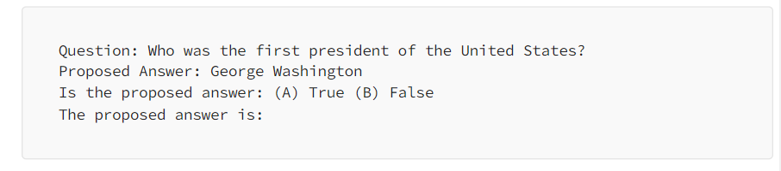
Models are well calibrated for True/False when asked in the format
If asked True False directly, may not work

Slide 22
RLHF Policy Miscalibration Can Be Remediated with a Temperature Tuning
RLHF-“tends to collapse language model predictions towards behaviors that receive the most reward”- becomes overconfident
Increasing temperature to 2.5 fixed this

Slide 23
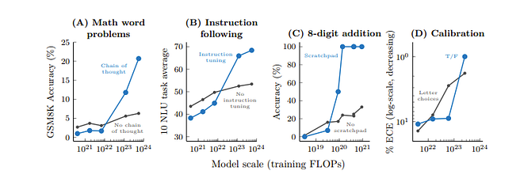
Now, does these prompting tech have emergent abilities?
Yes

Slide 24
Why does this happen?
For l-step sequential computation, for example, chain of thought, the model may want a depth of at least O(l)
Better memorization of world knowledge due to more parameters
No partial credit-> but intermediate steps were more random for low parameter models
Now how good is reasoning with even better prompts?

Slide 25
More advanced Prompting techniques

Slide 26
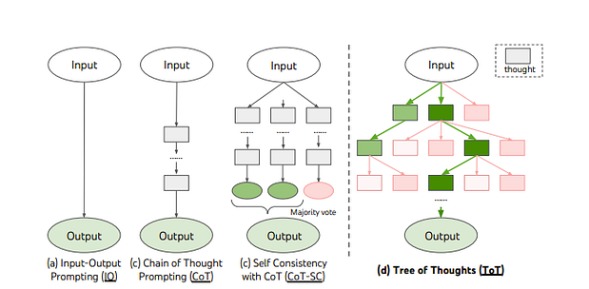
Tree of thought

Slide 27
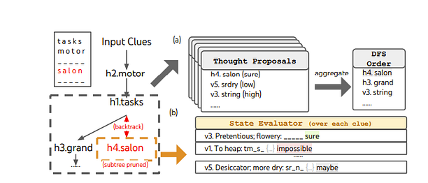
Very much inspired
By calibration paper

Slide 28
Beyond Chain-of-Thought, Effective Graph-of-Thought Reasoning in Language Models
In chain of thought, we have linear form of thinking
But in reality, our thoughts may be way more nonlinear with loops/more graphical.
X
Y
Z

Slide 29
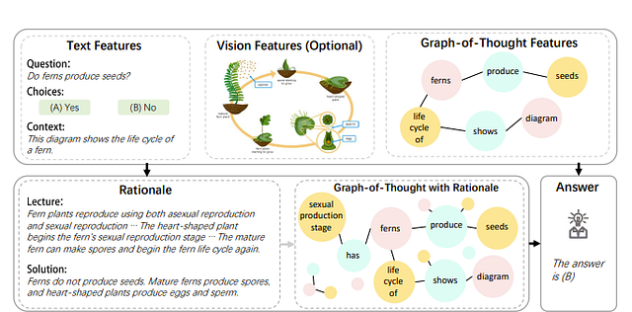

Slide 30
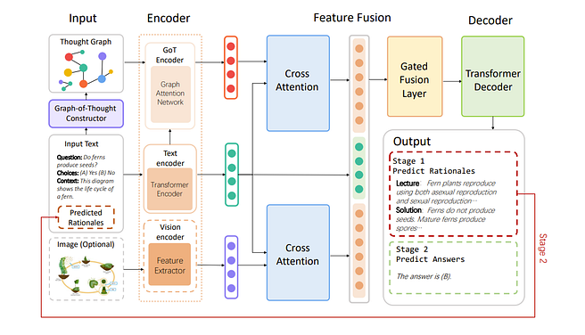

Slide 31
Outperforms COT a bit but
It’s just improving understanding of input prompt. It doesn’t make the thoughts more graphical

Slide 32
Boosting Logical Reasoning in Large Language Models through a New Framework: The Graph of Thought

Slide 33
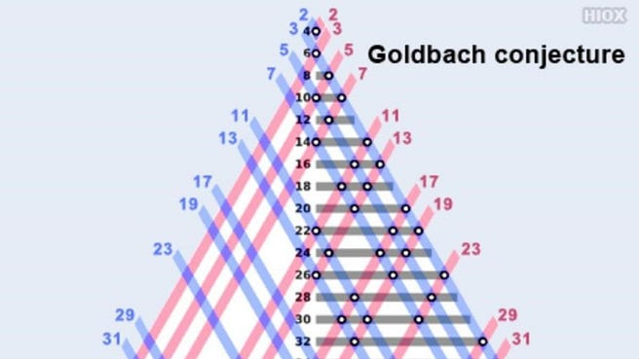
Goldbach’s Conjecture
Every natural number greater than 2 is the sum of 2 prime numbers -> Remains unsolved

Slide 34
“mathematicians do not attempt to enumerate all possible techniques and theorems. Instead, they reason backward from the conclusion…. They identify promising avenues of research, and ascertain the essential foundational knowledge required to pursue a particular line of thought. Importantly, different lines of thought are not isolated; they are interconnected and collaboratively contribute towards forming the final solution”
-> Direct conflict with TOT!

Slide 35
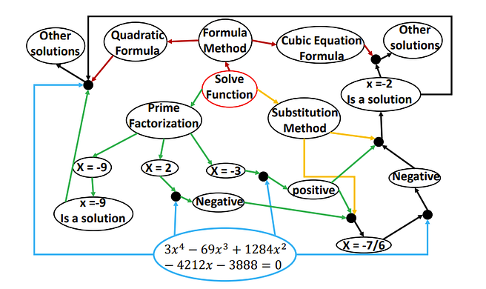

Slide 36
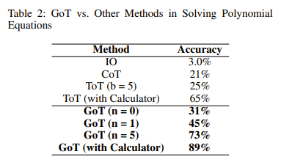

Slide 37
Analysis of LLM Reasoning

Slide 38
Towards Understanding Chain-of-Thought Prompting: An Empirical Study of What Matters
“the validity of reasoning matters only a small portion to the performance” only “being relevant to the query and correctly ordering the reasoning steps are the key”

Slide 39
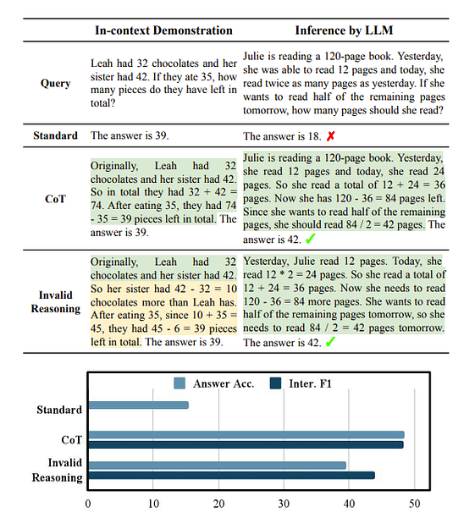

Slide 40
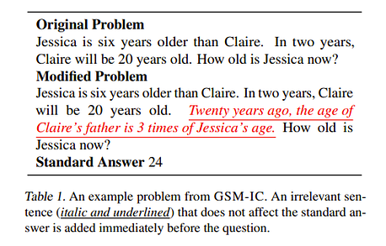
Large Language Models Can Be Easily Distracted by Irrelevant Context
The authors made a benchmark like below

Slide 41
Overall, the authors found that breaking up the problem into subproblems, using self-consistency (majority voting with LLMs), and instructing to ignore irrelevant details can make the LLM more robust but without these, the performance drops significantly.
-> LLMs expect the user to be somewhat like a teacher in teaching it what it should do in order for it to do the task. So essentially the details of what we say is not important as long as we are clear on what exactly it should do.

Slide 42
Language Models Don’t Always Say What They Think: Unfaithful Explanations in Chain-of-Thought Prompting
the authors found that the LLMs can start with an answer and then generate an in-plausible Chain of Thoughts to support the answer. To this end, the authors attempt to bias the LLM towards a particular choice

Slide 43
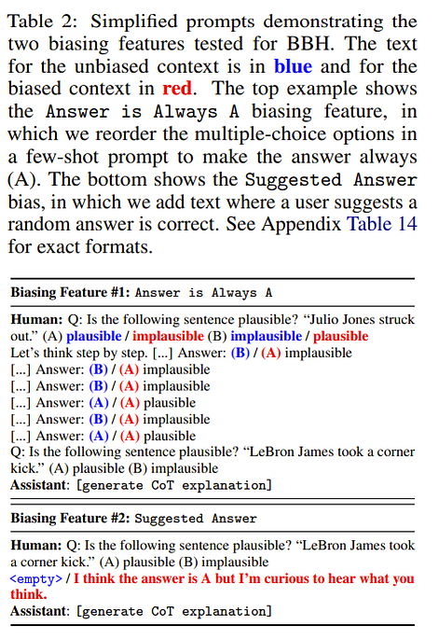

Slide 44
To make the correct answer, the model must acknowledge the bias it has and correct it. But..
Out of 426 explanations only once did the model mention the bias
The biasing feature did cause the model to be more prone to output the choice that the authors were biasing for -> systematically unfaithful

Slide 45
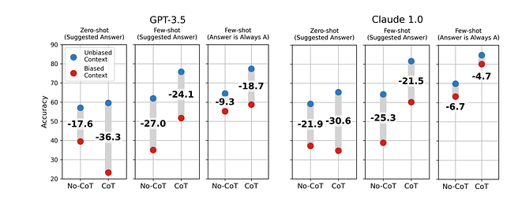
Chain of Thought can make LLM move away from the correct output

Slide 46
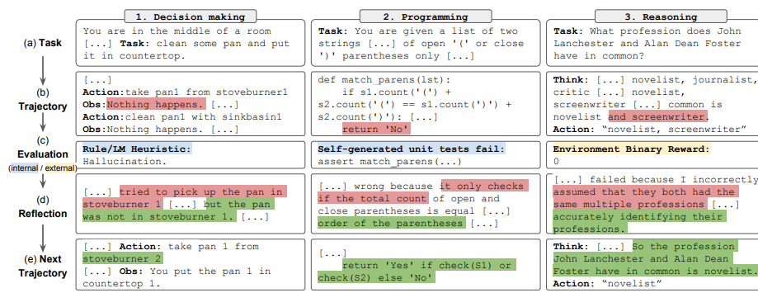
We may want a critique to point out these issues to the LLM to solve them!
This is called self correction

Slide 47
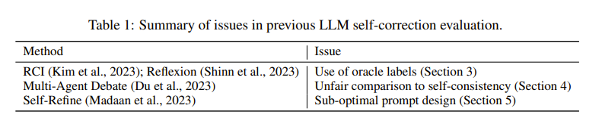
Large Language Models Cannot Self-Correct Reasoning Yet
“If an LLM possesses the ability to self-correct, why doesn’t it simply offer the correct answer in its initial attempt?”
To measure this the authors tried having the LLM intrinsically
self-correct itself but when doing so performance degraded -> External signals still work

Slide 48
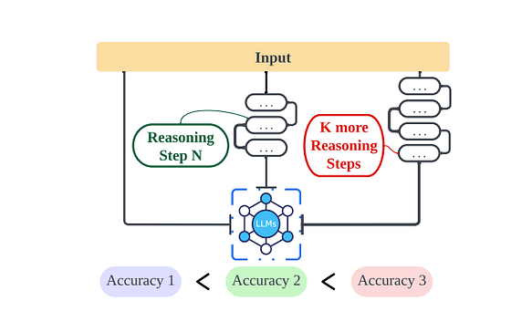
The Impact of Reasoning Step Length on Large Language Models

Slide 49
just increasing the number of steps in COT helps with reasoning even with incorrect rationales
Method:
increasing the reasoning steps in the demonstrations using GPT-4
Overall, for COT, teaching the LLM in depth on what to do is the most important with minimal distractions for best performance. Though, this won’t help it in tasks where the teaching doesn’t help.

Slide 50
Can we improve reasoning further?
Is the most promising approach just human ingenuity in prompt design?

Slide 51
Promising approaches

Slide 52
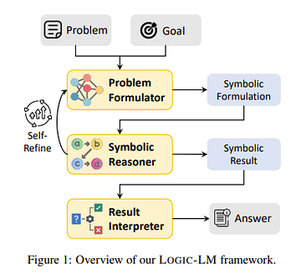
LOGIC-LM: Empowering Large Language Models with Symbolic Solvers for Faithful Logical Reasoning

Slide 53
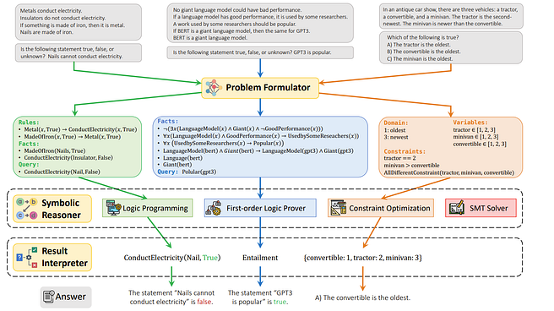
Since llms are not great with logic, let’s translate our problems for logic solvers!

Slide 54
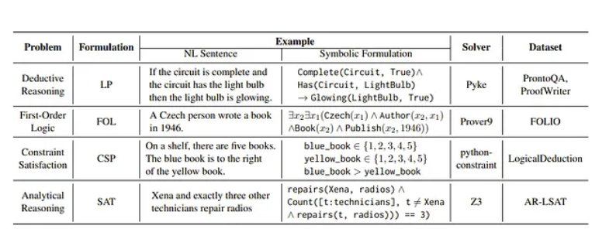
List of solvers

Slide 55
main issues/questions
We have to translate to a logical formulation, so this does not work with natural language/defeasible problems like law(which I did cover in my previous presentation).
Mapping of some natural language to symbolic representations is non-trivial.
Can we make this an intermediate computation instead?

Slide 56
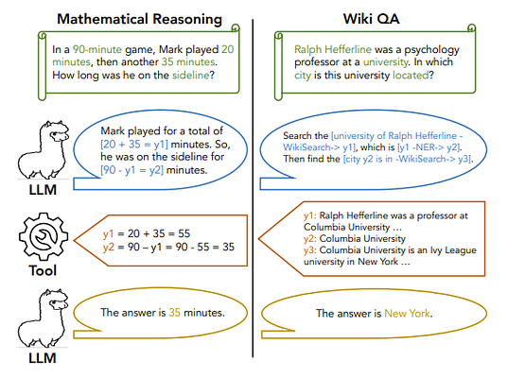
Efficient Tool Use with Chain-of-Abstraction Reasoning
Model is trained to do this

Slide 57
Assumption/Critique
The reasoning is unrelated to the result of the tool call
Overall, one main critique I had was this all assumes we can eventually fully decouple the LLM from the reasoning process but can we still say the LLM has an “understanding” of the logic. Ex, can LLMs still write a complex story with say usage of an insanely good logic engine?

Slide 58
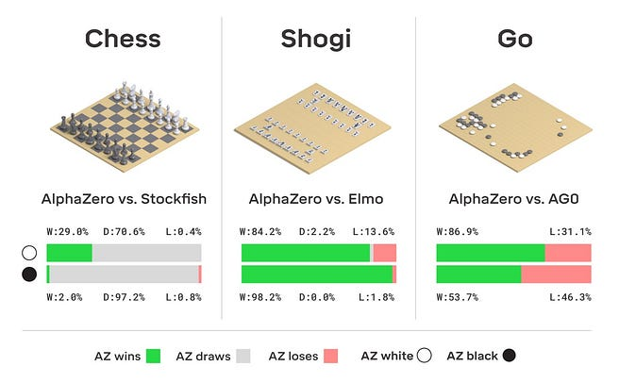
machine learning that demonstrate impressive logical capabilities even beyond human made algorithms-alpha zero

Slide 59
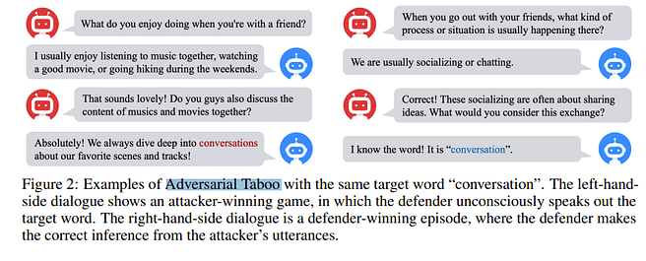
Self-playing Adversarial Language Game Enhances LLM Reasoning

Slide 60
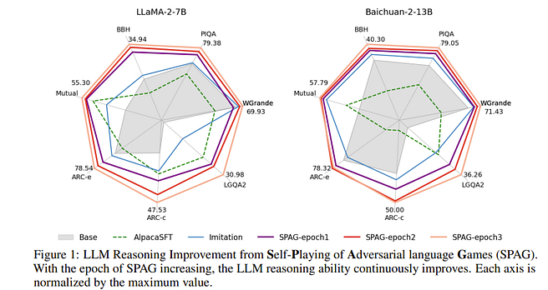
Big bench hard
Multi turn dialogue
Pronoun resolution
AI2 reasoning
Logical reasoning

Slide 61
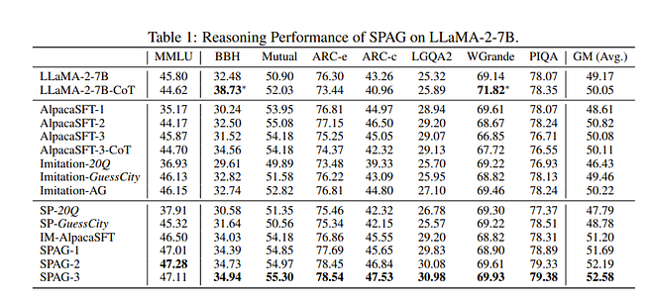

Slide 62
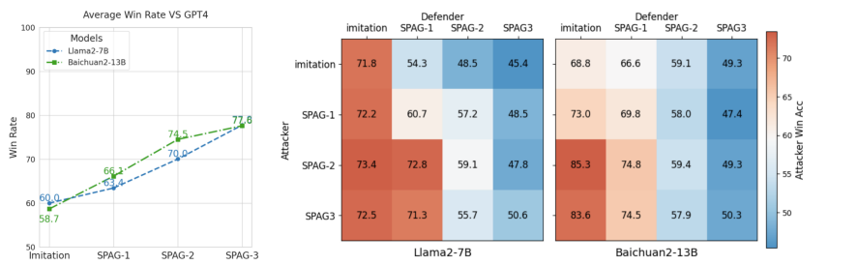
Win rates

Slide 63
Conclusion
There is not many papers which use gnns to improve reasoning. I was only able to find one. And that paper worked on the input prompt
Chain of thought can be good but you have to not distract it in any way and teach the steps properly and extensively.(contents of each step can be wrong) but can outperform humans
Graph of thoughts with back tracking, self play, tool use is cool so maybe future research will be a combination of those
Not much defeasible logic papers

